Slide 1





Bankruptcy Rules, Fee and Form Changes
Effective December 1, 2014

Slide 2
Bankruptcy Form Updates
These forms are revised to accommodate changes in the law as a result of Supreme Court precedent and as part of the Bankruptcy Rules Advisory Committees ongoing Forms Modernization Project.
Application for individuals to Pay the Filing Fee in Installments
Application to have the Chapter 7 Filing Fee Waived.
Summary (Summary of Schedules)
Chapter 7 Statement of Your Current Monthly Income/Calculation
Chapter 11 Statement of Your Current Monthly Income
Chapter 13 Statement of Your Current Monthly Income and Calculation of Commitment Period.
Chapter 13 Calculation of Your Disposable Income
Notice of Appeal and Statement of Election
Optional Appellee Statement of Election to Proceed in District Court
Certificate of Compliance with Rule 8015(1)(7)(B) or 8016(d)(2)

Slide 3
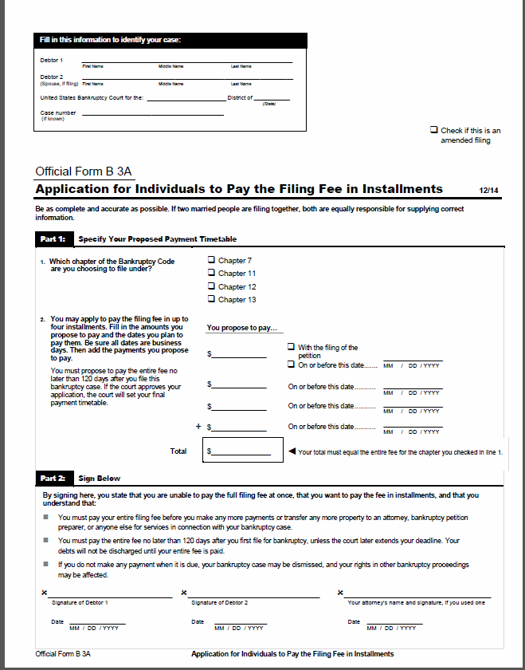
Bankruptcy Form Updates
B 3A- Application for Individuals to Pay the Filing Fee in Installments
**Filing Fee amounts for the various Chapters have been removed**

Slide 4
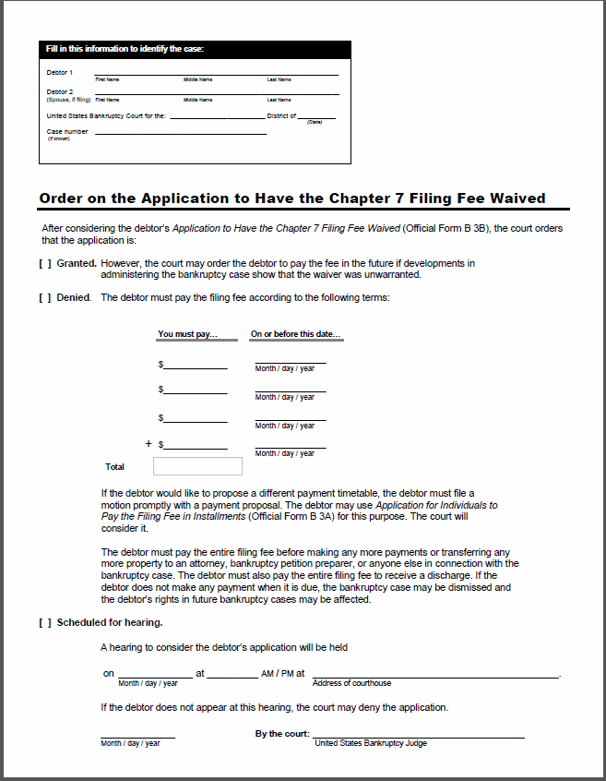
Bankruptcy Form Updates
B 3B- Application to have the Chapter 7 Filing Fee Waived
**The filing fee amount is no longer preprinted in the blank order. If the request is denied, the court will prepare the order with the correct fee.**

Slide 5
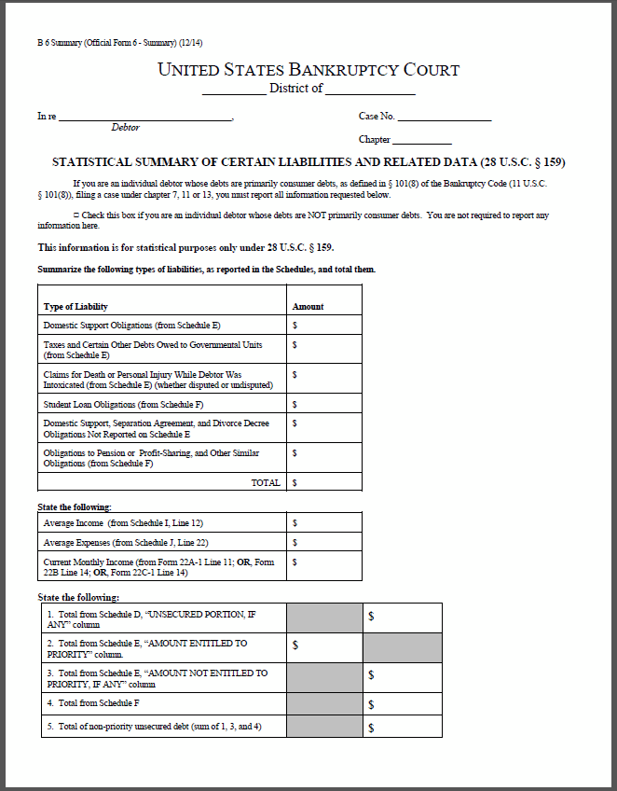
Bankruptcy Form Updates
B 06- Summary (Summary of Schedules)
**Updated to give line number reference to the amended means-test forms for current monthly income.**

Slide 6
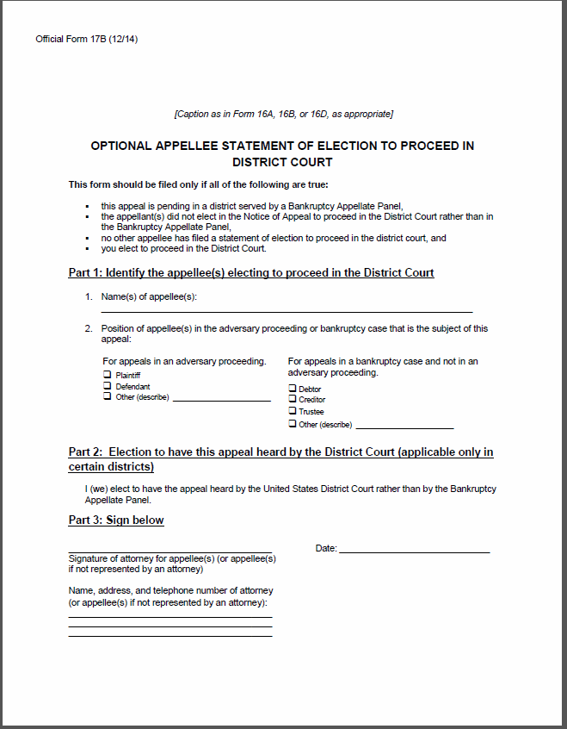
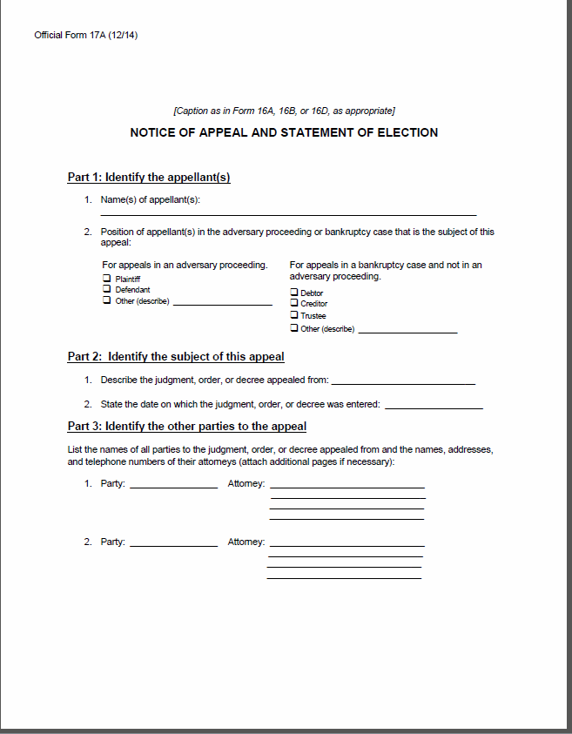
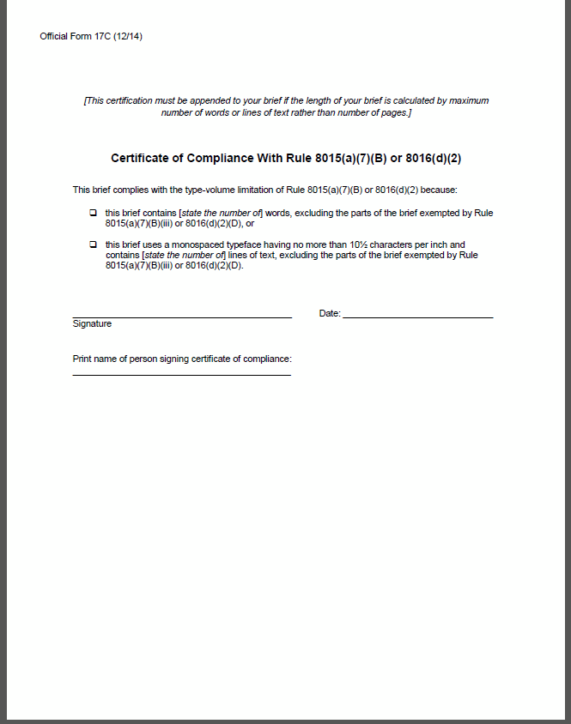
Bankruptcy Form Updates
Appeals and Statement of Election, B 17A, B 17B, B 17C
B17 A: Form 17A effectuates Rule 8005(a)’s requirement for election by an appellant by combining the notice of appeal and statement of election. It thereby facilitates compliance with the statutory requirement that an appellant wishing to make an election do so at the time of filing the appeal. 28 U.S.C. § 158(c)(1)(A).
B 17C: New form. Rules 8015(a)(7)( c) and 8016 (d) (3) require an attorney or unrepresented party to certify that the brief complies with the applicable type-volume limitation. Completion of this form satisfies that certification requirement. Form not needed if the brief meets the applicable page limitation under the rule.
B 17B: This form is new. Official form for an appellee to state its election to have an appeal heard by the district court rather than by the bankruptcy appellate panel.

Slide 7
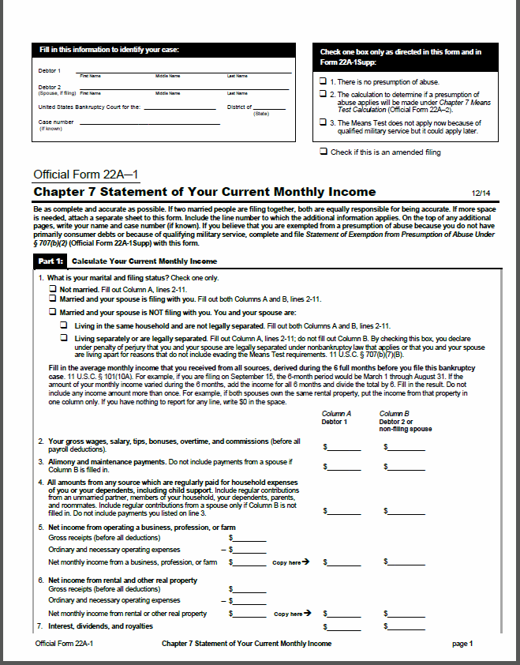
Bankruptcy Form Updates
B 22A-1 Chapter 7 Statement of Your Current Monthly Income
**This form will determine current monthly income and compare whether the income is more than the median income for households of the same size. If the income is NOT above the median, there is no presumption of abuse and the second form (B 22A-2) will not have to be filled out.**

Slide 8
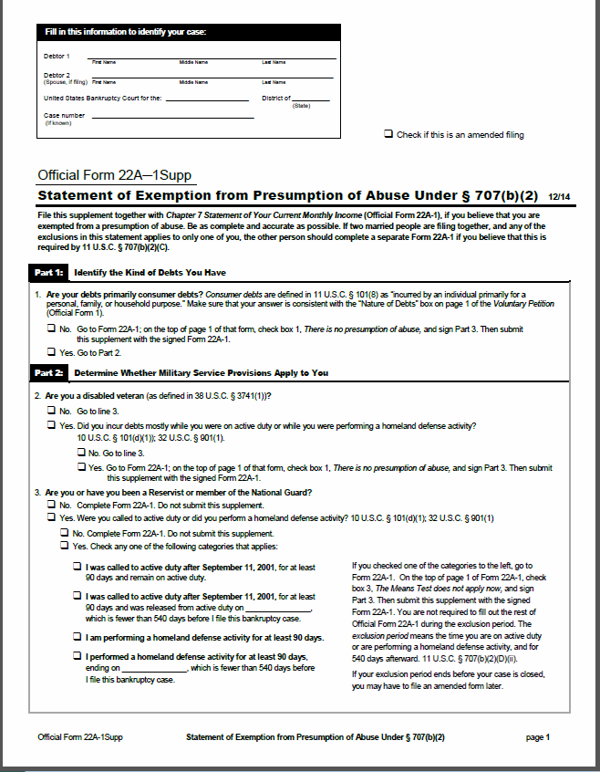
Bankruptcy Form Updates
B 22A-1Supp Supplement Statement of Exemption from Presumption of Abuse under § 707(b)(2)
**This form determines whether one can be exempt from the presumption of abuse due to no primary consumer debts, or certain military/homeland defense services have been provided on form B 22A-1. If exemptions apply, form 22A-1 and 22A-1supp must be filled out and filed.**

Slide 9
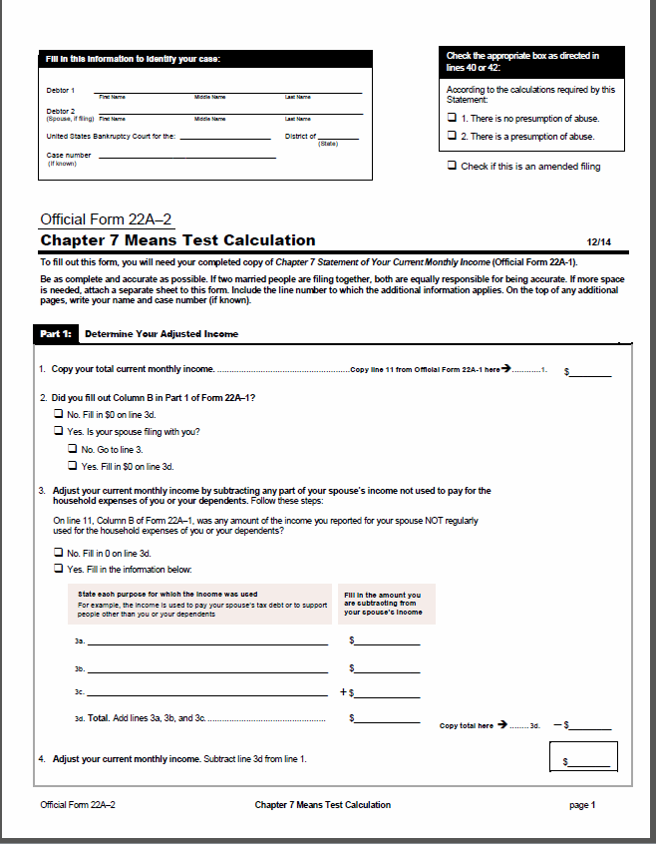
Bankruptcy Form Updates
B 22A-2 Chapter 7 Means Test Calculation
**This form is used alongside form 22A-1=if income shows to be above the median income of same size household.**

Slide 10
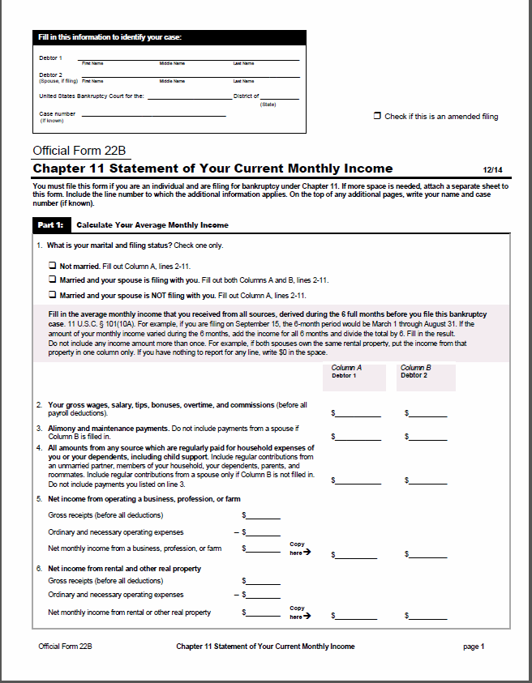
Bankruptcy Form Updates
B 22B Chapter 11 Statement of Your Current Monthly Income
The form has been revised so that individuals completing the form would do so more accurately and completely.

Slide 11
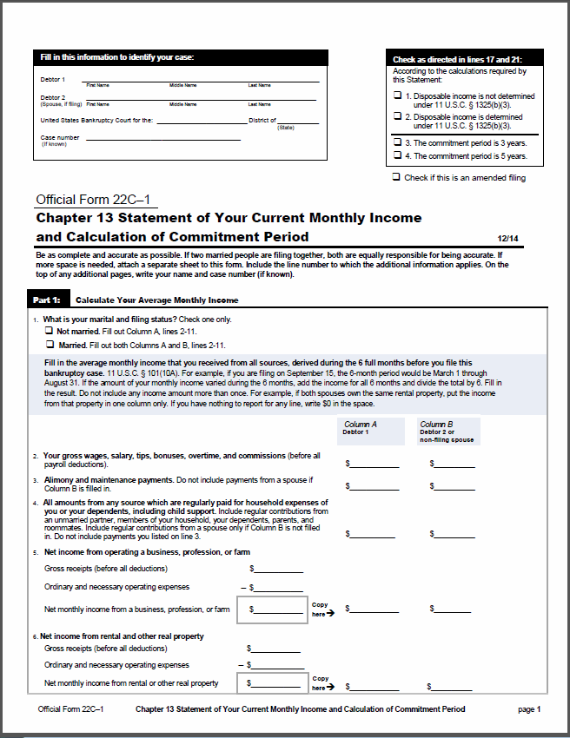
Bankruptcy Form Updates
B 22C-1 Chapter 13 Statement of Your Current Monthly Income and Calculation of Commitment Period
**This form will report current monthly income and determine whether the income is at or below the median income for households of the same size. If the income is equal to or less than the median the second form 22C-2 WILL NOT need to be filled out.**

Slide 12
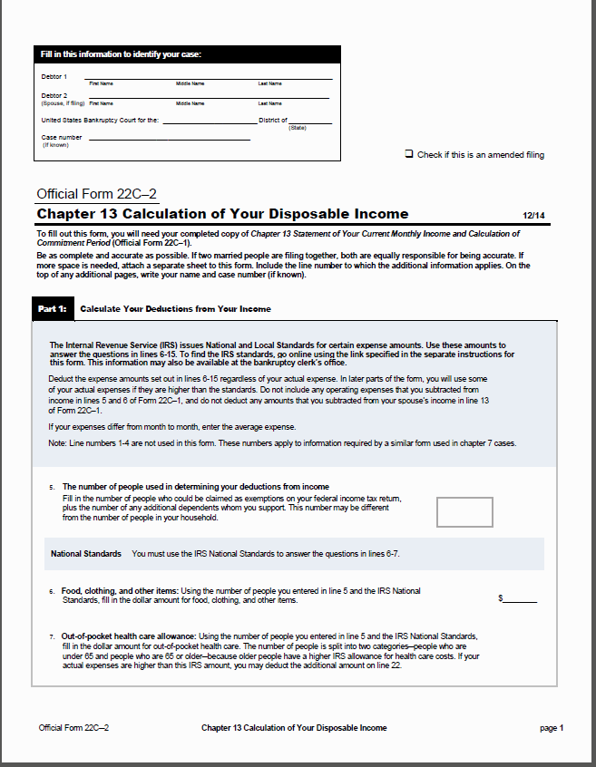
Bankruptcy Form Updates
B 22C-2 Calculation of Disposable Income
**If income is above the median, this form (22C-2) must be filed along side form 22C-1.**

Slide 13

Fee Changes and Updates

Slide 14
Fee Changes
Upon notice from the court of appeals that a direct appeal or direct cross-appeal has been authorized, an additional fee must be collected.
Previous Fee→ $157
New Fee → $207

Slide 15
**NEW Fee**
**Per the Bankruptcy Miscellaneous Fee Schedule, section (11) was modified to clarify that a case need not be reopened if redaction is the only reason for reopening.**
FRBP 9037(a) Motion to Redact a record per affected case
Fee → $25

Slide 16

Bankruptcy Rules Updates

Slide 17
Rule 1014 (b)
Dismissal and Change of Venue
Subdivision (b) was amended -proceedings in subsequently filed cases are stayed only upon order of the court in which the first-filed petition is pending.
Expands the list of persons entitled to receive notice of the motion in the first court.

Slide 18
Rule 7004 (e)
Process; Service of Summons, Complaint
Subdivision ( e) amended to shorten time to serve a summons from 14 to 7 days after issuance.

Slide 19
Rule 7008 (b) / Rule 7054 (b)
General Rules of Pleading Rule 7008 (b)
Judgments; Costs Rule 7054 (b)
Generally these rules change the procedure for seeking attorney’s fees in bankruptcy proceedings aligning them closer to the Civil Rules.
Subdivision (b) is deleted. This section required a request for attorney’s fees always to be pleaded as a claim in an allowed pleading.
Subdivision (b) amended to included much of the substance of Rule 54(d)(2) which sets out the procedures for seeking an award of attorney’s fees.

Slide 20
Rule 9023
New Trials; Amendments of Judgments
Amended to include a cross reference to Rule 8008 which governs Indicative Rules.

Slide 21
Rule 9024
New Trials; Amendments of Judgments
Amended to include a cross reference to Rule 8008 which governs Indicative Rules.

Slide 22
Rule 8001
Scope of Part VIII Rules; Definition of “BAP” Method of Transmission
Previous Rule 8001 --provides for the manner of taking an appeal.
--Associated with 1st Cir. BAP L.R. 8001-1 --
New→ (c) method of transmission requires electronic transmission unless a party is pro se, then it should be sent by mail; transmission via ECF will suffice.

Slide 23
Rule 8002
Timing for Filing Notice of Appeal
NEW→ Mostly stylistic changes and some language changes; the time to file remains 14 days.
An appeal by an inmate is timely filed if it is deposited in the institution’s internal mail on or before the last day for filing. Appeal must include an affidavit to that effect.

Slide 24
Rule 8003
Appeal as of Right-How Taken, Docketing the Appeal
Previous Rule 8001, 8003, 8004, 8007
--New 1st Cir. BAP L.R. 8003-1 emphasizes the need for the information included on Official Form 17A (NEW FORM)--
(a)(1) Appeal must be timely filed with the Bankruptcy Clerk of Court.
(a)(3)(A) The appeal must conform substantially to Official Form 17A and include a copy of the judgment, order or decree being appealed.

Slide 25
Rule 8003 continued…..
(b) Two or more parties to an appeal can file a joint notice of appeal.
( c)(1)-(3) Bankruptcy clerk must serve the notice of appeal on counsel for each party to appeal, the UST and any pro se party. Service of the appeal by the bankruptcy court must be noted on the docket—name of party served, date, and method.
Failure to serve does not affect validity of the appeal.
Transmit the appeal promptly to the BAP or District Court.

Slide 26
Rule 8004
Appeal by Leave-How Taken, Docketing the Appeal
Previous Rule 8001(b), 8003
--Former 1st Cir. BAP L.R. 8001-3 –
NEW FORM 17A
(a) To appeal from an interlocutory order, a party must file with the bankruptcy court a notice of appeal and a motion for leave to appeal and a copy of the order.
(b) Responses to the motion must be filed directly with the BAP/District Court.
(c) Appeal and Motion must be promptly transmitted to the BAP or District Court.
.

Slide 27
Rule 8005
Election to Have an Appeal Heard by the District Court instead of the BAP
Previous Rule 8001
--Associated with 1st Cir. BAP L.R. 8005-1 emphasizes the need for the appeal to conform to 17A and include the statement of election.–
**NEW FORMS 17A, 17B (to be filed with the BAP; it is the appellee election to District Court. )**
(a) Statement of election can now be included within the notice of appeal and is no longer required to be a separate document. Must conform substantially to Official Form 17A

Slide 28
Rule 8005 continued….
(b) Bankruptcy clerk to transmit to District Court if election is checked. If appellee files a statement of election with the BAP, BAP must transmit to District Court and notify Bankruptcy court.
( c) A motion seeking the determination of the validity of an election must be filed no later than 14 days after the statement of election is filed.
NEW EVENTS:
1.) Notice of Appeal and Statement of Election
2.) Appellee Statement of Election

Slide 29
Rule 8006
Certifying a Direct Appeal to the Court of Appeals
Previous Rule 8001(f)
Reformatted and edited to identify new Rule number references.

Slide 30
Rule 8007
Stay Pending Appeal; Bonds; Suspension of Proceedings
Previous Rule 8005 F.R.App.P.8
--Associated with 1st Cir. BAP L.R. 8007-1--
Reformatted and edited for clarity and to identify new Rule number references.

Slide 31
Rule 8008
Indicative Rulings
Previous Rule -- F.R.CivP.62.1, F.R. AppP.12.1
--Associated with 1st . Cir. BAP L.R. 8008-1--
New→ (a) Relief pending appeal: The Bankruptcy Court may consider a timely filed motion that it lacks authority to grant and determine it may:
Defer consideration pending appeal;
Deny the motion; or
State that the court would grant motion if the issue was remanded for that purpose, or state that the motion raises a substantial issue.

Slide 32
Rule 8008 continued…
(b) Notice to the court where the appeal is pending.
If (a)(3) is true then the movant must notify the clerk of court for the appeal.
(c) Remand after indicative ruling
DC or BAP may remand but retains jurisdiction unless the appeal is expressly dismissed;
Parties must notify appeals court clerk when BK court has decided the motion on the remand.

Slide 33
Rule 8009
Record of Appeal; Sealed Documents
Previous Rule 8006
--Associated with 1st Cir. BAP L.R. 8009-1--
Subsections (a) through ( e) and (g) reformatted and edited to identify new Rule number references and improve clarity.
NEW→ Subsection (f) prescribes the treatment of sealed documents designated as part of the record on appeal.
NEW EVENTS:
1.) Statement of Evidence in Lieu of Transcript
2.) Response to Statement of Evidence in Lieu of Transcript
3.) Transcript Ordered
4.) Certification of no Transcript Ordered
5.) Agreed Statement in Lieu of ROA

Slide 34
Rule 8010
Completing and Transmitting the Record
Previous Rule 8007
--Associated with 1st . Cir. BAP L.R. 8010-1(a) and (b)--
New→ (a) If there was no reporter at the hearing, the transcriptionist is designated as the Reporter for the purpose of the rule.
NEW→(a)(2)(A) rule makes clear that the receipt acknowledgment must be “filed” with the bankruptcy court.
(a)(2) (B) Reworded instruction: File the transcript with the bankruptcy court clerk, who then has the responsibility to notify the appropriate appeals clerk.

Slide 35
(a)(2) (C) Reworded to instruct reporter to request extension of time from the bankruptcy court clerk ONLY.
(a)(2) (D) Reworded to indicate that the bankruptcy court clerk is responsible for notifying the bankruptcy judge when a transcript is untimely. (Removes ref to BAP clerk).
(b) Clerk’s Duties (OLD 8007(b))
(1) Transmitting the Record-In General: Instructs Bk Clerk to transmit the record OR a notice that the record is available electronically.
May be sent electronically.
NEW → (b)(2) Multiple Appeals: If there are multiple appeals from a decision the Bk clerk must transmit a single record.

Slide 36
(b)(3) Receiving the Record; AND
(b)(4) If Paper Copies are Ordered: Conform substantially to the last few sentences of OLD 8007(b) in simpler language.
NEW→ (b)(5) When leave to Appeal is Requested: If a motion for leave to appeal has been filed, the BK clerk prepares and transmits the record only after the motion is granted.
(c) Record for a preliminary motion in the district court, bap, or court of appeals. (OLD 8007(c))
Substantially similar, reformatted, and edited for clarity and to identify new Rule number references.

Slide 37
Rule 8011
Filing and Service Signature
Previous Rule 8008
--Associated with 1st . Cir. BAP L.R. 8008-1--
Filing.
NEW→ (1) With the Clerk- expressly directs that documents be filed with the appropriate appeals clerk.
(2) Method and Timeliness:
& (B) Are substantially similar to the first full sentence of OLD 8008(a), reformatted and edited for clarity and to identify new Rule number references.

Slide 38
NEW→ (C) Inmate Filing : Same requirements as 8002(c).
(D) Copies (CHANGED) (last half of OLD 8008(a): Copies not required unless specifically required in a particular proceeding or by local rule.
NEW→ (3) Clerk’s Refusal of Documents : Expressly forbids the clerk from refusing any document for filing solely because it is not in proper form.
(b) Service of all documents required: Conforms to OLD 8008(b)
(c) Manner of service (updated to require electronic service) OLD 8008(c).

Slide 39
Methods: Service must be made electronically except on or by non-registered CM/ECF users, or if local rules permit. Service on unrepresented parties may be made by:
(A) personal delivery;
(B) mail;
NEW→ (C) Third party commercial carrier for delivery within 3 days.
(2) When Service is Complete (EXPANDED): On electronic transmission, unless there is notice that transmission was unsuccessful. Service by mail is complete on mailing, and on delivery to a commercial carrier.

Slide 40
(d) Proof of service (old 8008(d))
(1) What is Required & (2) Delayed Proof: Substantially conform to old 8008(d);
NEW→ (3) Brief or Appendix Conforms proof of service required by Rule 8009 to (1), above.
NEW→ (e) Signature: Documents filed electronically must include an electronic signature of the filer or counsel, meeting Judicial Conference standards; Paper documents must include the signature of the filer or counsel.

Slide 41
Rule 8012
Corporate Disclosure Statement
NEW RULE
--Associated with 1st . Cir. BAP L.R. 8012-1--
NEW→ Any nongovernmental corporate party appearing in the district court or BAP must file a statement that identifies any parent corporation and any publicly held corporation that owns 10% or more of its stock or states that there is no such corporation.

Slide 42
Rule 8013
Motions; Intervention
Previous Rule 8011
--Associated with 1st . Cir. BAP L.R. 8011-1, 8011-2--
(a) Contents of a motion; response;
Reply.
NEW→ (1) & (2) (A) is substantially similar to the first full sentence of OLD 8011(a)
NEW→ (2) (B) Motion to expedite an appeal. Establishes a procedure to expedite an appeal provided a valid justification is considered.

Slide 43
NEW→ (2) (C) (i)(ii)(iii) Accompanying documents : Rule establishes the documents required to accompany a motion. (i) Affidavit in support of motion. (ii) Affidavit must contain only factual information. (iii) Copies of Judgment, order or decree must be included as separate exhibit.
NEW→ 2 (D) Documents barred or not required (i)(ii) A separate brief supporting or responding to a motion must not be filed and notice of motion or a proposed order is not required.

Slide 44
NEW→ 3 (A) & (B) Response and reply; time to file: Set the parties response time to 7 days after the service of the motion.
(b) Disposition of a motion for a procedural order. Substantially similar to the OLD 8011(b) - Rule add a period of 7 days for affected party to move to reconsider, vacate order modify order.
NEW→ (c) Oral argument: A motion will be decided without oral argument unless the district court or BAP orders otherwise.
(d) Emergency motions (1)(2)(3) is substantially similar to the of OLD 8011(d)

Slide 45
(e) Power of a single bap judge to entertain a motion - Rule is substantially similar to the of OLD 8011(e)
NEW→ (f) Form of documents; page limits; number of copies.
(1) Format of a paper document, Rule 27(d)(1) F.R. App. P. applies.
(2) Format of an electronically filed document. Must comply with the requirements for a paper version regarding covers, line spacing, margins, typeface, and type style. It must also comply with the page limits

Slide 46
(3) Page limits.
a motion or a response to a motion must not exceed 20 pages
(B) a reply to a response must not exceed 10 pages.
(4) Paper copies. Paper copies must be provided only if required by local rule
NEW→ (g) Intervening in an appeal - an entity that seeks to intervene in an appeal pending in the district court or BAP must move for leave to intervene and serve a copy of the motion on the parties to the appeal. The Motion must be filed within 30 days after the appeal is docketed.

Slide 47
Rule 8014
Brief
Previous Rule 8009
--Associated with 1st . Cir. BAP L.R. 8010-1--
(a) This rule addresses the format and filling requirements of Appellant's briefs.
(b)This rule addresses the format and filling requirements of Appellee's briefs.
(c)This rule addresses the format and filling requirements of Reply to briefs.
(d) This rule addresses the statutes, rules, regulations, or similar authority requirements of briefs.

Slide 48
(e) This rule addresses briefs in a case involving multiple appellants or appellees.
(f) This rule addresses citation of supplemental authorities.

Slide 49
Rule 8015
Form and Length of Briefs; Form of Appendices and Other Papers
Previous Rule 8010
--Associated with 1st . Cir. BAP L.R. 8009-1, 8010-1 and 8015-1—
Official Form B 17C
This rule addresses the format and length of briefs and appendices.

Slide 50
Rule 8016
Cross-Appeals
New Rule
Official Form B 17C
This rule addresses cross-appeals.
(a) Applicability - This rule applies to a case in which a cross-appeal is filed.
(b) Designation of appellant - These designations may be modified by the parties’ agreement or by court order.

Slide 51
(c) Briefs
(1) Appellant’s Principal Brief. The appellant must file a principal brief in the appeal. That brief must comply with Rule 8014(a).
(2) Appellee’s Principal and Response Brief. - That brief must comply with Rule 8014(a), except that the brief need not include a statement of the case unless the appellee is dissatisfied with the appellant’s statement.
(3) Appellant’s Response and Reply Brief. - That brief must comply with Rule 8014(a)(2)-(8) and (10), except that none of the following need appear unless the appellant is dissatisfied with the appellee’s statement in the cross-appeal

Slide 52
(4) Appellee’s Reply Brief. That brief must comply with Rule 8014(a)(2)-(3) and (10) and must be limited to the issues presented by the cross-appeal.
(d) Length
(1) Page Limitation. Unless it complies with paragraphs (2) and (3), the appellant’s principal brief must not exceed 30 pages; the appellee’s principal and response brief, 35 pages; the appellant’s response and reply brief, 30 pages; and the appellee’s reply brief, 15 pages.
(2) Type-Volume Limitation. - it contains no more than 14,000 words; or it uses a monospaced face and contains no more than 1,300 lines of text.,

Slide 53
The appellee’s principal and response brief is acceptable if: (i) it contains no more than 16,500 words; or (ii) it uses a monospaced face and contains no more than 1,500 lines of text.
(e) Time to serve and file a brief
(1) the appellant’s principal brief, within 30 Days
(2) the appellee’s principal and response brief, within 30 days after the appellant’s principal brief is served;
(3) the appellant’s response and reply brief, within 30 days after the appellee’s principal and response brief is served; and

Slide 54
(4) the appellee’s reply brief, within 14 days after the appellant’s response and reply brief is served, but at least 7 days before scheduled argument.

Slide 55
Rule 8017
Brief of an Amicus Curiae
Derived from F.R. App.P 29
This is substantially similar to F. R. App.P. 29 and governs the procedure for filing an amicus curiae brief.

Slide 56
Rule 8018
Serving and Filing Briefs; Appendices
Previous Rule 8009
--Associated with 1st . Cir. BAP L.R. 8018-1--
Amended (a)(1) Appellant must serve and file brief w/in 30 days after the docketing of ntc that the record has been transmitted or is available electronically. [Old rule 8009 – 14 days after entry of the appeal on the docket]
Amended (a)(2) Appellee – serve and file brief w/in 30 days after service of the appellants brief [Old Rule 8009 – 14 days]

Slide 57
Amended (a)(3) Appellants reply brief may be filed within 14 days after service of the appellee’s brief, but it must be filed at least 7 days before scheduled argument, unless BAP and DC allow a later filing. [Removes reference to deadline to file briefs if cross appeal has been filed.]
NEW→ Amended (a)(4) Appellee who fails to file a brief will not be heard at oral argument unless DC and BAP allow.
(b)Duty to Serve and File an Appendix to the Brief. (b)(1) Appellant must serve and file with its brief excerpts of the record as an appendix [Removed – if appeal is to the BAP].
(b)(1)(A)-(F) outlines what should be in the appendix. Removes specific reference to old 8009(b)(2) and (6), pretrial order and motion and response on which the court rendered decision.

Slide 58
(b)(2) Appellee may serve and file an appendix with its briefs, material required to be included by the appellant or relevant to the appeal or cross appeal, but omitted by the appellant.
(b)(3) Cross appellee – appellant as cross appellee may file appendix
(c) Format of appendix
(d) Exhibits – May be contained in a separate volume[s].
(e)Appeal on the Original Record Without an Appendix. USDC or BAP may dispense with appendix.

Slide 59
Rule 8019
Oral Argument
Previous Rule 8012 and F.R. App.P. 34
--Associated with 1st . Cir. BAP L.R. 8019-1--
Party’s Statement – same as Old Rule 8012
(b) Presumption of Oral Argument and Exceptions. This is the same as Old rule 8012
NEW→ (c) Notice of Argument; Postponement. USDC and BAP must advise all parties of the date, time and place for oral argument and the time allowed for each side. Motion to Postpone must be filed within a reasonable time.

Slide 60
(d) Order and Contents of Argument. New Appellant opens and concludes argument.
NEW→ (e) Cross-Appeal and Separate Appeals. if there is a cross-appeal, Rule 8016(b) determines which party is the appellant and which the appellee for oral argument purposes. Cross Appeal or separate appeal must be argued when the initial appeal is filed.
NEW→ (f) Nonappearance of a Party. If appellee or appellant fails to appear, court may hear opposing side’s arguments. If both fails to appeal, court may decide case on the briefs.
NEW→ (g) Submission on Briefs. Parties may agree to submit a case for decision on the brief. Court may direct that case be argued.

Slide 61
(h) Use of Physical Exhibits at Argument; Removal. (NEW) Physical exhibits must be placed in courtroom on day or argument before court begins. Counsel must remove exhibit from the courtroom after the argument. The Clerk may destroy exhibits if counsel does not reclaim them within a reasonable time.

Slide 62
Rule 8020
Frivolous Appeal and Other Misconduct
Derived from former Rule 8020, F.R. App.p 38 and 46 (c)
--Associated with 1st . Cir. BAP L.R. 8020-1--
NEW→ (a) Frivolous Appeal – Damages and Costs – subsection (a) is substantially similar to old Rule 8020
(b)Other Misconduct. (NEW) Provides that the District Court or BAP may discipline or sanction an attorney or party for other misconduct including failure to comply with Ct order. Court must afford reasonable notice, opportunity to show cause and hearing, if requested.

Slide 63
Rule 8021
Costs
Previous Rule 8014 and F.R. App.P 39
NEW→ Subsection (a)(1)-(4) Against Whom Assessed. – Previous Rule 8014 simply states that the losing party to the appeal bears the costs. New 8021 specifically spells out who bears the cost if the appeal is dismissed, reversed, etc.
NEW→ (b)Costs for and Against the United States. – Costs for or against the US, its agency or officer may be assed under subdivision (a) only if authorized by law.
(c) Costs on Appeal Taxable in the Bankruptcy Court – reorders 8014 and enumerates the specific costs that can be taxed.

Slide 64
NEW→ (d) Bill of Costs; Objection. –A party who wants costs must within 14 days after entry of the judgment on appeal, file with the bankruptcy clerk, w/ proof of service, and itemized and verified bill of costs. Objections there to must be filed within 14 days after service of the bill of costs.

Slide 65
Rule 8022
Motion for Rehearing
Derived from former Rule 8015 and F.R. App.P 40
--Associated with 1st . Cir. BAP L.R. 8022-1--
*Deletes the provision regarding the time for appeal to the court of appeal as this matter is address in F.R.App.P.*
6(b)(2)(A)
(a)(1) Time – Old rule 8015
NEW→ (a)(2)Contents – motion must state each point of law or fact that movant believes USDC or BAP overlooked and must argue in support of the motion. Order argument is not allowed.

Slide 66
NEW→ (a)(3) Response – No response permitted.
(a)(4) Action by the District Court or BAP. – New Outlines what the Court may do if the motion for rehearing is granted.
NEW→ (b) Form of the Motion; Length. –Motions must comply with Rule 8013(f)(1) and (2). Copies must be served as proved by Rule 8011. Motion must not exceed 15 pages

Slide 67
Rule 8023
Voluntary Dismissal
Previous Rule 8001
Clerk of District Court or BAP must dismiss an appeal if the parties file a signed dismissal agreement specifying how costs are to be paid and pay any outstanding fees. Appeal may be dismissed on appellant’s motion on terms agreed to by the parties or fixed by the court.

Slide 68
Rule 8024
Clerk’s Duties on Disposition of the Appeal
Previous Rule 8016; and adapted from F.R. App.P 36 and 45 (c) and (d)
--Associated with 1st . Cir. BAP L.R. 8024-1--
Reworded to reflect that only items in the record that are physically, as opposed to electronically, transmitted to the USDC or BAP need to be returned to the bankruptcy clerk. Other Changes are stylistic.

Slide 69
Rule 8025
Stay of District Court or BAP Judgment
Previous Rule 8017
NEW→ Mostly stylistic changes, subdivision (c)– If USDC or BAP affirm the bankruptcy court ruling and the appellate judgment is stayed, the bankruptcy court’s order, judgment or decree that is affirmed on appeal is automatically stayed to the same extent as the stay of the appellate judgment.

Slide 70
Rule 8026
Rules by Circuit Councils and District Courts; Procedure When There is no Controlling Law
Previous Rule 8018
--Associated with 1st . Cir. BAP L.R. 8026-1--
Changes to this rule are stylistic

Slide 71
Rule 8027
Notice of a Mediation
NEW RULE
Requires the USDC or BAP clerk to advise the parties promptly after an appeal is docketed of any court mediation procedure. The notice must state what the mediation requirements are and how the procedure affects the time for filing briefs.

Slide 72
Rule 8028
Suspension of Rules in Part VIII
Previous Rule 8019 and F.R. App.P.2
Amended to include additional {newly added} rules that the BAP and USDC may not suspend.

